Slide 1
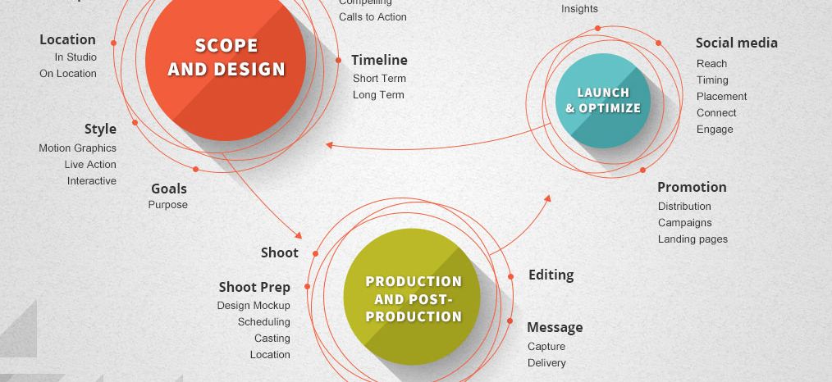

CS Task 2 – SE Process
Team Green
Technik und Informatik / Medizininformatik

Slide 2
SE Process
Pro (PD) | Con (PD) | Pro (AG) | Con (AG)
good structure of process | not exact information is at hand | better interaction because of interfaces | interaction with all clients is difficult
many different ideas how software should work |  | error discovery is fast (data structure)
we need specification before the implementation |  | software can be used earlier in the process (with restrictions)
 |  | we are a small team-able to communicate easy
 |  | not all the team members have profound knowledge of programming
PD = plan driven |  | AG = agile
Notes:
Health Visitor = Gesundheitsbeauftragte (Staat, Bund, etc.)
Health Service Manager = Verantwortlicher Finanzen, tägl. Abläufe Spital*

Slide 3
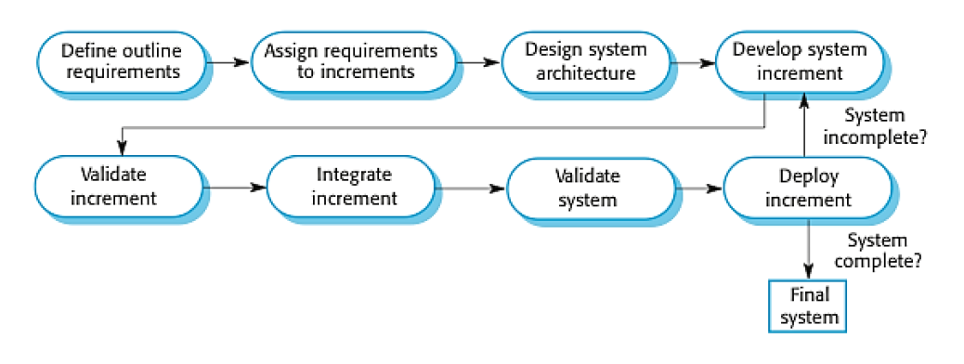
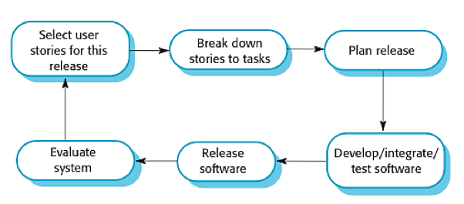
SE Process
Based on our evaluation we decided to make a combination of plandriven and agile
Incremental Delivery and Extreme Programming

Slide 4
Process Model
Activity | Goal | Tasks | Potential Output
Specification | Description of the product in general and we choose the most important use cases to implement | Describe what is the vision of the project and which are the most important use cases for the beginning | A part of the specification
Developement (with minimal testing) | Implement the defined use cases | Implement the defined use cases | First version of the product
Feedback/Validation | Check the implementation | Talk with the customer | Feedack
Test | First implementation is working without errors | Make testcases and test the product | First (next) version of the product which is working ( Fixed errors)
…………… | ………………… | …………………. | ………………….
Final version | A good product which is working without errors | Go on production | Release: Final product

Slide 5
Relation among outputs of different activities
A part of the specification
We need the specification to produce the first version
First version of the product
We need to present the first version to get a feedback
Feedback
Release: First (next) version of the product which is working ( Fixed errors)
We need the feedback to fix the errors and to add missing demands or delete not needed demands
……
We need to repeat the whole process until we get our final working version
Final Product

Slide 6
Involvement of stakeholders
The customer gets involved with the development team to give the required information
Users and management are a part of the customer ( they interact with each other)
The development team is responsible to arrange new meetings
users
management
customer
development team

